Slide 1
Logic Gates and Circuits

Slide 2
Index
Logic Gates
NOT gate
BUFFER gate
AND gate
OR gate
XOR, NAND, NOR gates
Multiple inputs gates
Definition of digital circuits
Multiple implementations
Bus
Boolean Algebra
Combinational or Sequential
Rules of combinational composition
Examples
Complexity
Simulation

Slide 3
Logic Gate definition
Logic gates are simple digital circuits that take one or more binary inputs and produce a binary output
drawn with a symbol showing the input and the output
inputs are on the left (or top) and outputs on the right (or bottom)
The relationship between inputs and output is described with a truth table or a boolean equation
a truth table lists inputs on the left and the corresponding output on the right, using one row for each possible combination of inputs
a boolean equation is a mathematical expression using binary variables

Slide 4
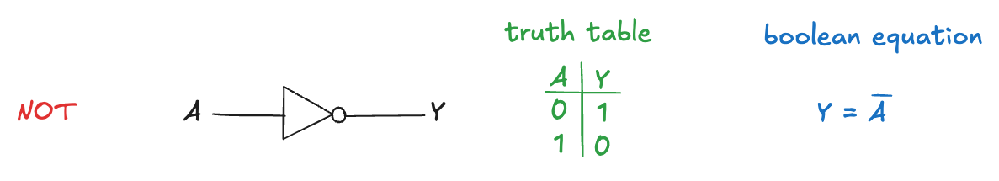
NOT gate
A NOT gate has one input, A, and one output, Y which is the inverse of the input
If A is FALSE, then Y is TRUE
If A is TRUE, then Y is FALSE
This relationship is summarized by the following truth table and boolean equation:
The line over A is pronounced NOT: “Y equals NOT A”
The NOT gate is also called an inverter

Slide 5
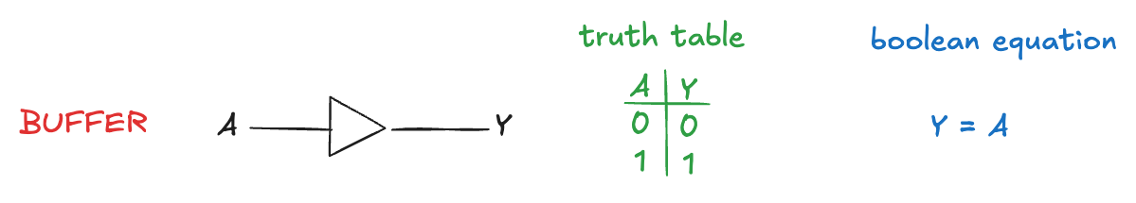
BUFFER gate
The other one-input logic gate is called a buffer: it simply copies the input to the output:
From the logical point of view, it is no different from a wire
it might seem useless
From the analog point of view, the buffer has desirable characteristics
ability to deliver large amounts of current to a motor
the ability to quickly send its output to many gates
We need to consider multiple levels of abstraction to fully understand a system
the digital abstraction hides the real purpose of a buffer

Slide 6
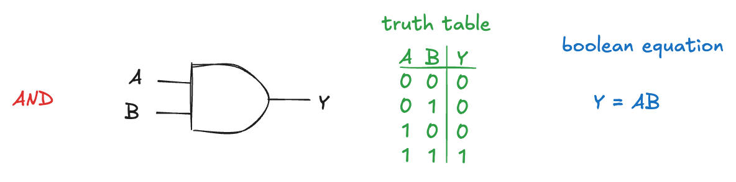
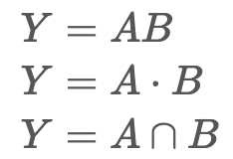
AND gate
The AND gate is a two-input logic gates that produces TRUE if and only if both inputs are TRUE; otherwise, the output is FALSE
The boolean equation can be written in several ways:
the “intersection” is preferred by logicians
digital designers use the dot or simple juxtaposition

Slide 7
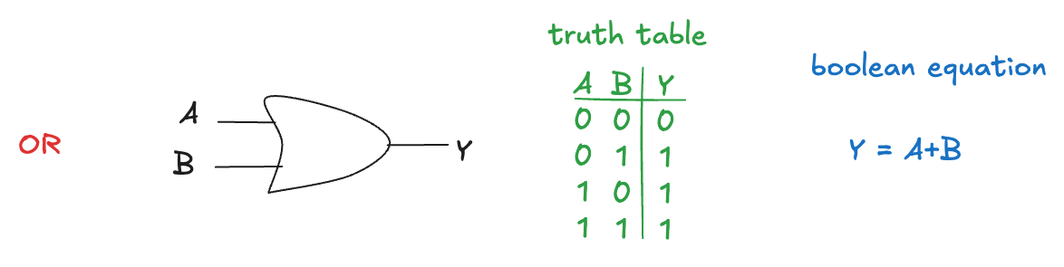
OR gate
The OR gate produces TRUE if one input (or both) is TRUE
The boolean equation is written as
Y=A+B or Y=A∪B
∪ symbol is pronounced “union” and is preferred by logicians
digital designers normally use the + notation, pronounced “Y equals A or B”

Slide 8
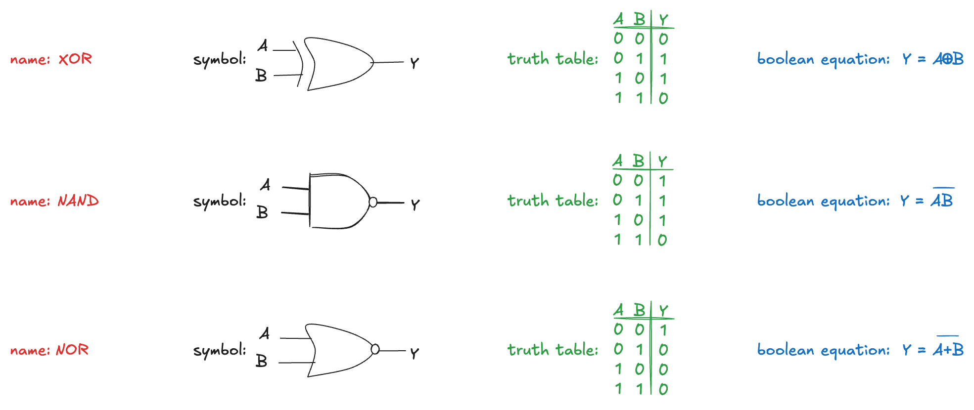
XOR, NAND, NOR gates
Other common two-input logic gates are:
XOR (exclusive OR, pronounced “ex-OR”) is TRUE if A or B, but not both, are TRUE
it is indicated by ⊕ (a plus sign with a circle around it)
NAND gate performs NOT AND. Its output is TRUE unless both inputs are TRUE
NOR gate performs NOT OR. Its output is TRUE if neither A nor B are TRUE

Slide 9
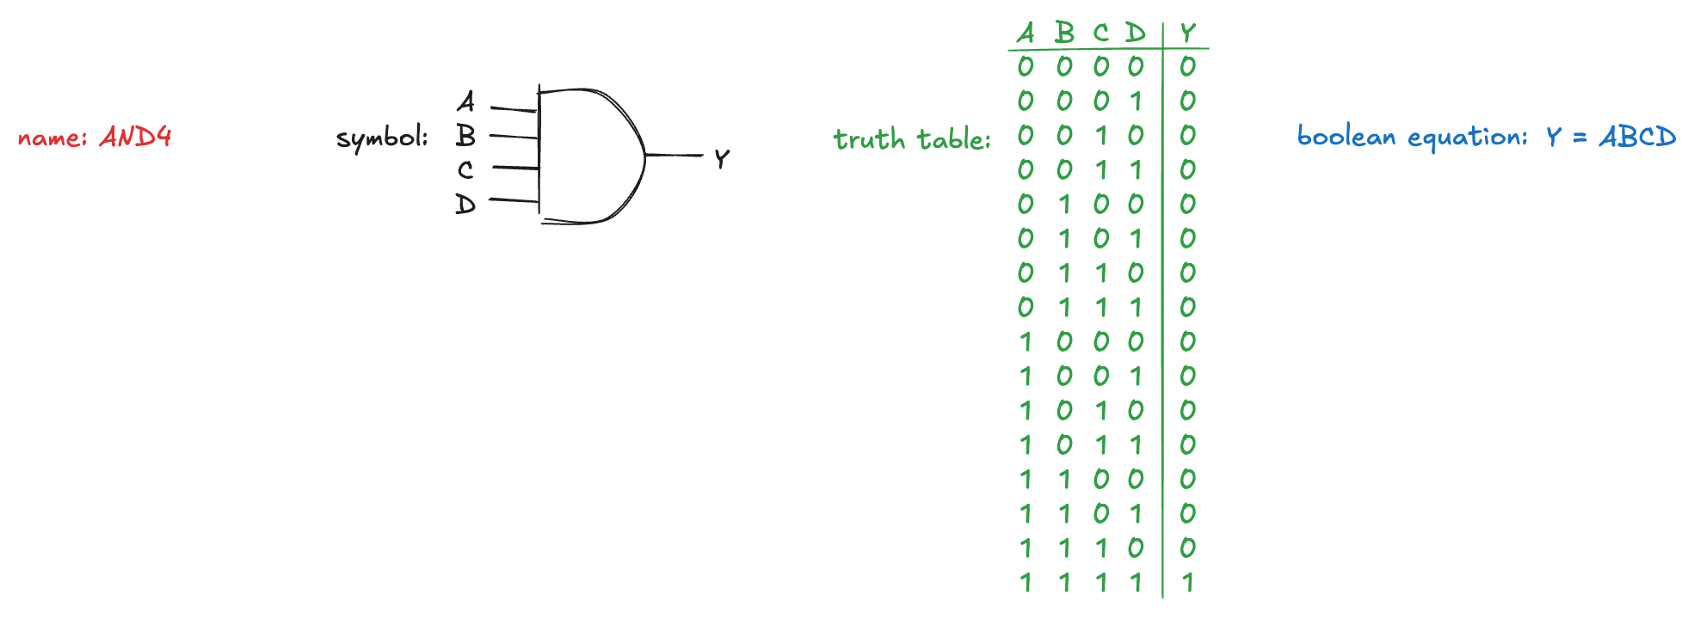
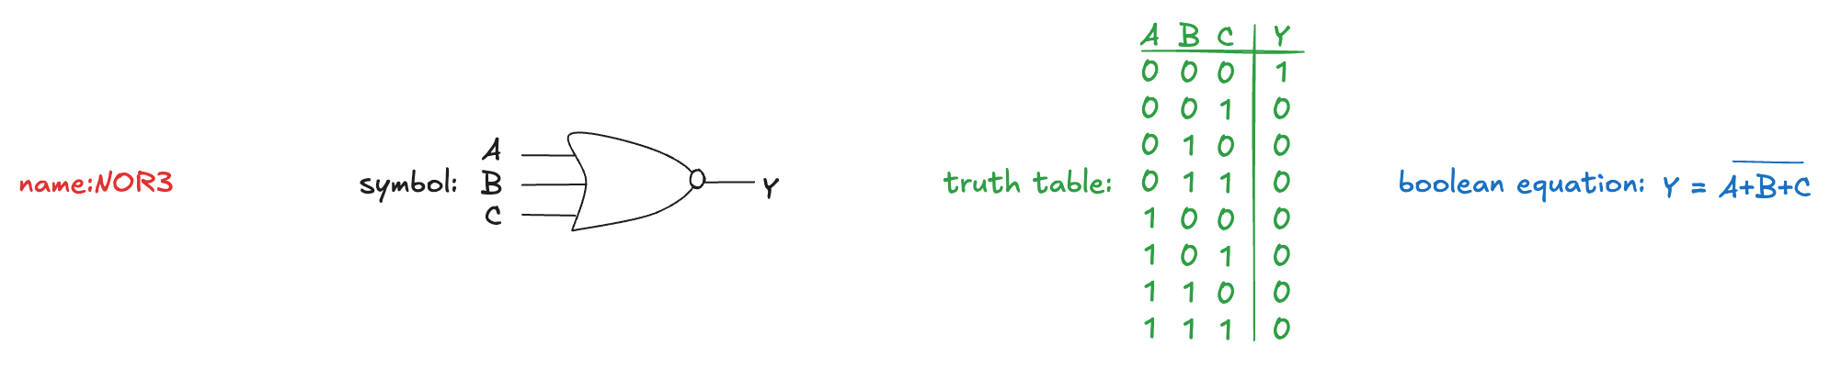
Multiple inputs gates
Many boolean functions of three or more inputs exist:
an N-input AND gate produces a TRUE output when all N inputs are TRUE
An N-input NOR gate produces a TRUE output when all N inputs are is FALSE

Slide 10
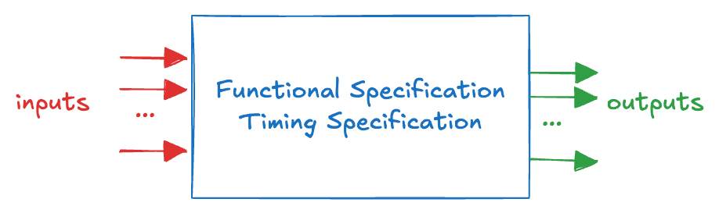
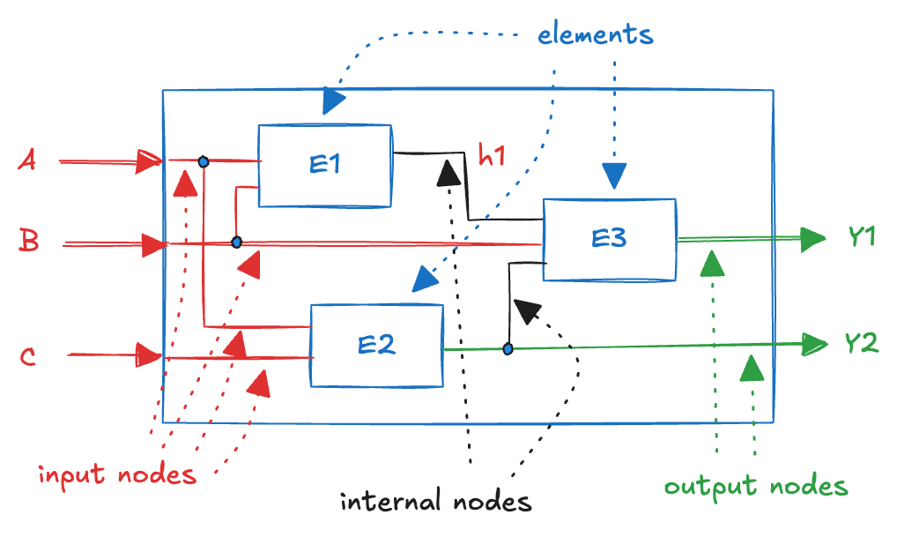
Digital Circuit
A network that processes boolean variables
a black box with one or more input terminals and one or more output terminals
a functional specification describing the relationship between inputs and outputs
a timing specification describing the delay between inputs changing and outputs responding
Inside the black box, circuits are composed of nodes and elements
elements are circuits with inputs, outputs, and specifications
nodes are wires, whose voltage conveys a boolean variable
Node types:
input node
receives values from the external world
output node
delivers values to the external world
internal node
not inputs or outputs

Slide 11
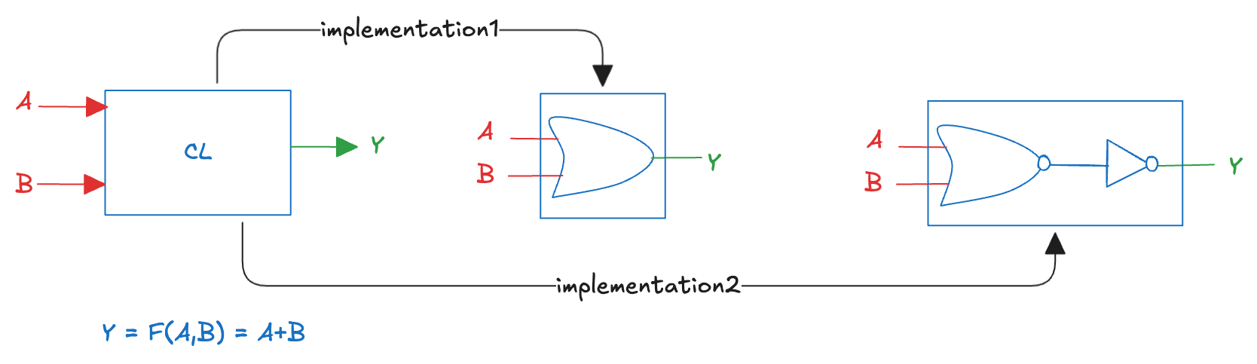
Multiple implementations
There are often many implementations for a single function:
We choose given the building blocks at our disposal and our design constraints (area, speed, power, etc)

Slide 12
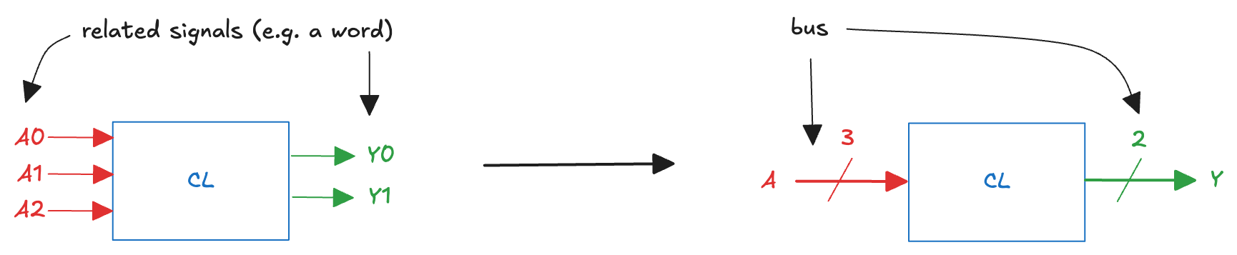
Bus
A bundle of multiple signals.
a single line with a slash through it and a number next to it

Slide 13
Boolean Algebra
The mathematical framework for representing and manipulating logical expressions
AND, OR, and NOT are the fundamental logical operators
it is an algebraic system (a set of elements to which a set of operations is associated), deﬁned by:
the set of values {0,1}
the operations OR, AND, and NOT
the equivalence operator “=”
We call Boolean variable any discreet variable that can assume only two values
We call Boolean function any expression F expressed using the logical operations, that takes one or more binary inputs (X1, X2, …, Xn) and produces a binary output (Y)
its domain is composed of all the 2^n combinations of the values of the variables
the domain is countable
it can be represented by its boolean expression or by its truth table

Slide 14
Combinational or Sequential
Combinational circuit: output depends only on the current values of the inputs
combines the current input values to compute the output
a logic gate is a combinational circuit
memoryless
Sequential circuit: output depends on both current and previous values of the inputs
depends on the input sequence
has memory

Slide 15
Rules of combinational composition
How we can build a large combinational circuit from smaller combinational circuit elements
A circuit is combinational if it consists of interconnected elements such that
every element is itself combinational
every node is either an input or connects to exactly one output of an element
it contains no cyclic paths: every path through the circuit visits each element at most once
The rules are sufficient but not necessary
certain circuits that disobey these rules can be still combinational
we restrict ourselves to combinational composition to build combinational circuits

Slide 16
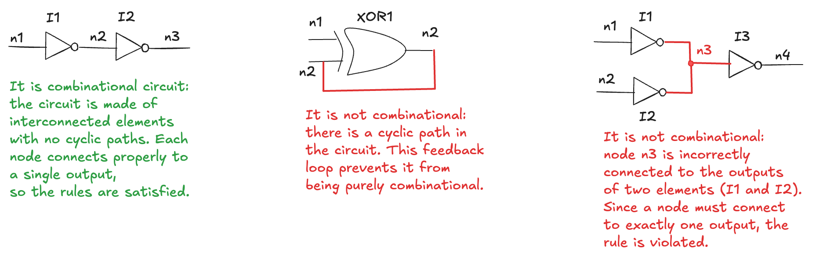
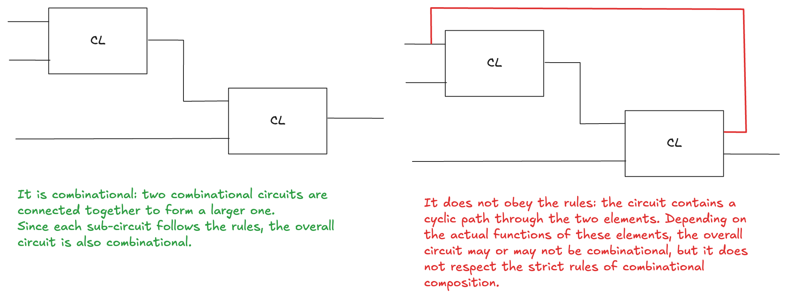
Examples of circuits

Slide 17
Complexity
Large circuits such as microprocessors can be very complicated, so we use the principles to manage this complexity:
view a circuit as a black box with a well-defined interface and function (abstraction and modularity)
building the circuit out of smaller circuit elements (hierarchy)
the rules of combinational composition (discipline)
The functional specification of a combinational circuit is usually expressed as a truth table or a boolean equation
how to implement the basic gates AND, OR and NOT?
how to derive a boolean equation from any truth table?
how to use boolean algebra to simplify boolean equations?

Slide 18
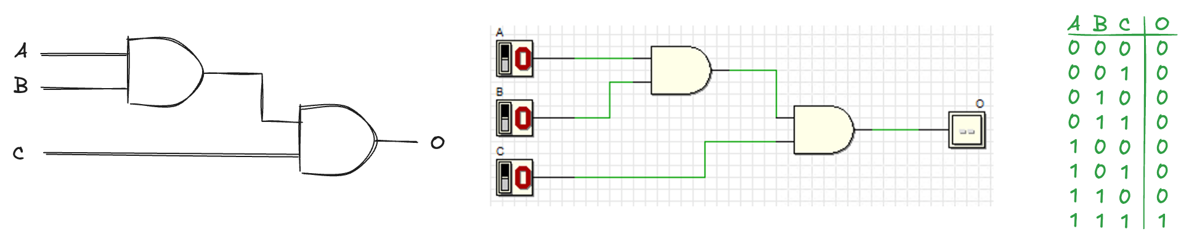
Simulation (1)
Verify correctness
check that the circuit produces the expected outputs for all possible inputs.
Explore behaviour over time
visualize how signals change, and how they affect the output
Experiment freely
try variations, optimize the design, and gain intuition about circuit behaviour without worrying about damaging components
Deeds

Slide 19
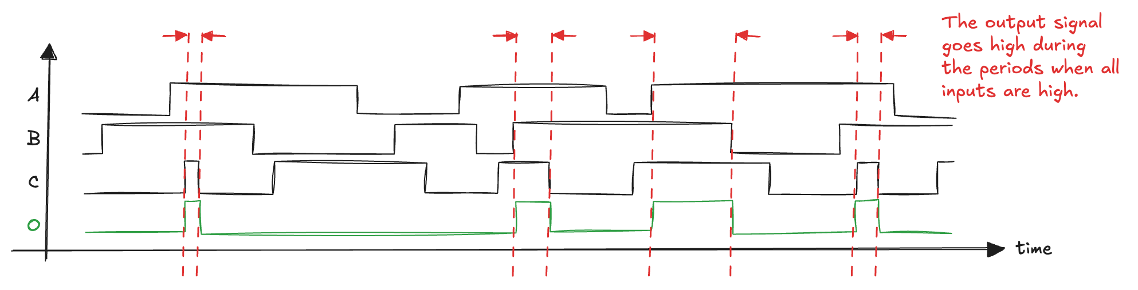
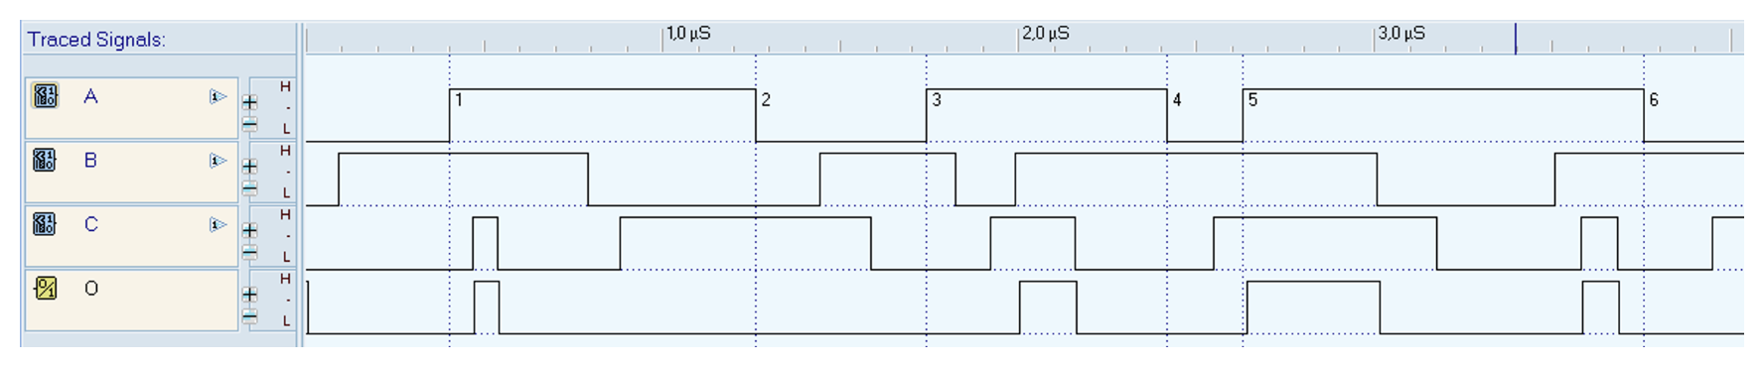
Simulation (2)
A timing diagram is a graphical representation of how signals change over time
It shows the relationship between input and output signals, helping us understand when the output becomes high or low depending on the inputs

